Slide 1
Maze Project
Prepared for Professor Henry Chang
Created by Nur A Farabi (12455)
Fall 2021
Northwestern Polytechnic University
Fremont, California

Slide 2
Subjects
Table of Content
Introduction
Desgin
Implementation
Enhancement Ideas
Conclusion

Slide 3
Table of Content
What is Maze problems?
How to find shortest path in a maze?
How to use Dijkstra’s Algorithm to find shortest path of a maze?
Design
Implement

Slide 4
What is Maze problem?
A Maze is a collection of all path to a destination.
How to find shortest path in a Maze?
There are two mostly used algorithm to solve the find shortest path in a maze. Those are:
Dijkstra’s Algorithm
Bellman Ford Algorithm
How to use Dijkstra’s Algorithm to find shortest path of a maze?
Draw the all possible path to destination
Reduce unnecessary path to destination
We will find our desire path.

Slide 5
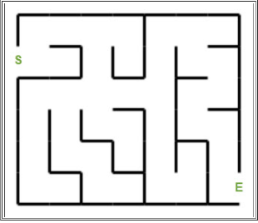
Design
Given Maze

Slide 6
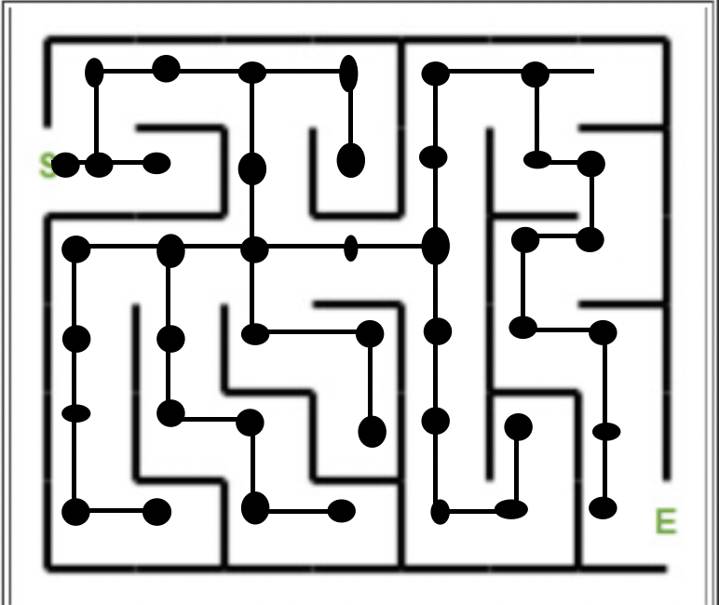
Draw all Possible path to destination

Slide 7
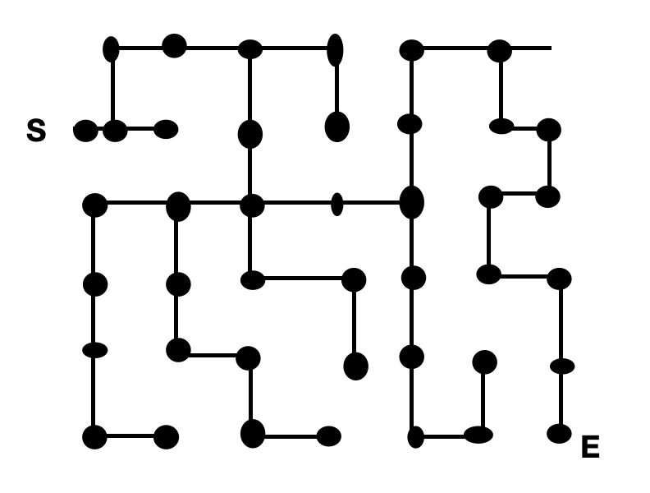
Remove maze and show only path

Slide 8
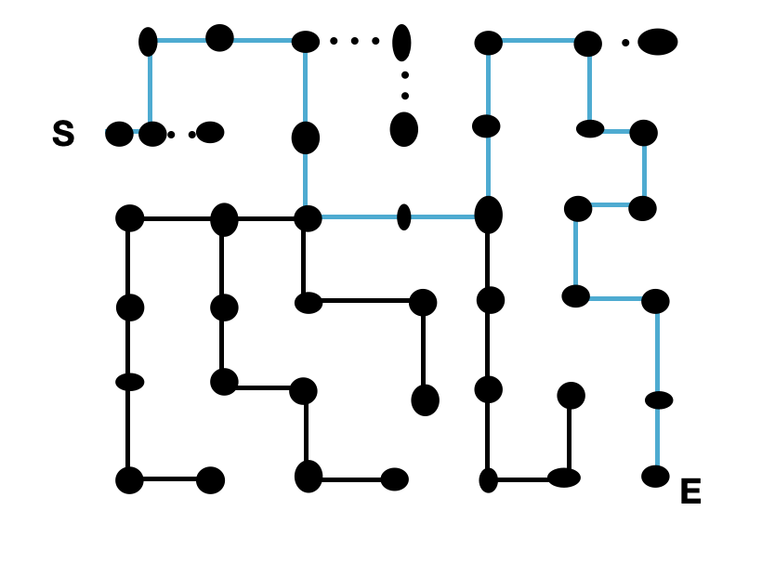
Only keep necessary path

Slide 9
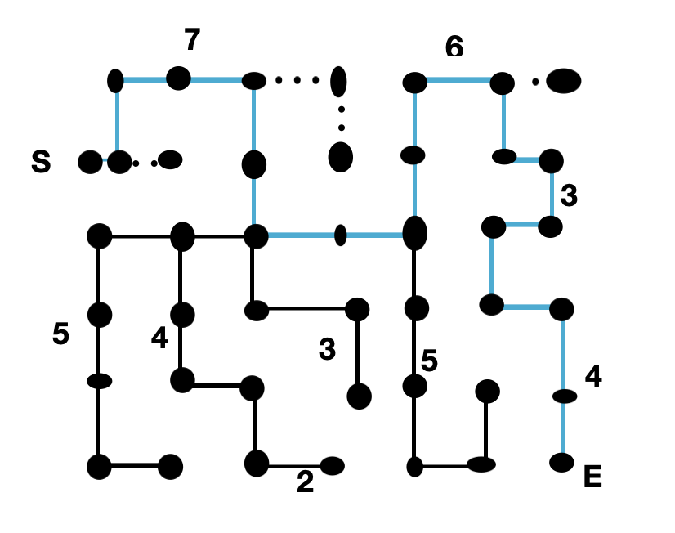
Find the shortest path

Slide 10
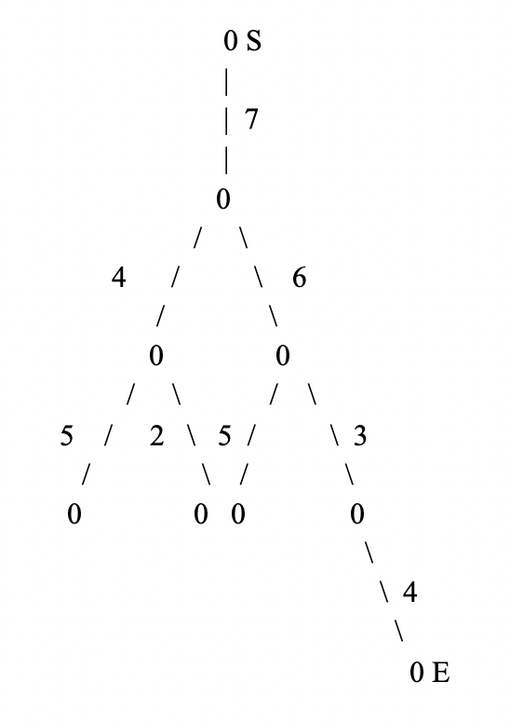
Spanning tree

Slide 11
Conclusion
Using Dijkstra’s Algorithm it is easy to solve any maze problem.

Slide 12
Thank You

